Slide 1





Where’s the thief?

Slide 2
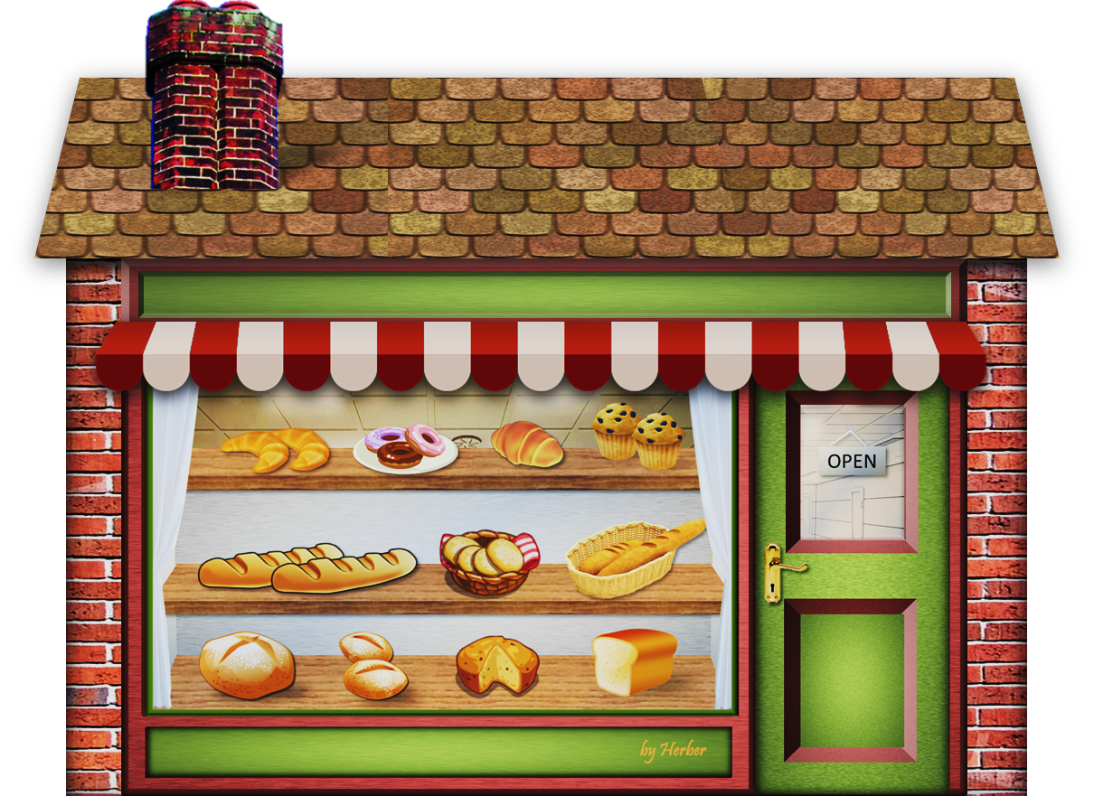


I’m going to steal some biscuits and bread.
Where is he?

Slide 3


He is in the BAKERY

Slide 4
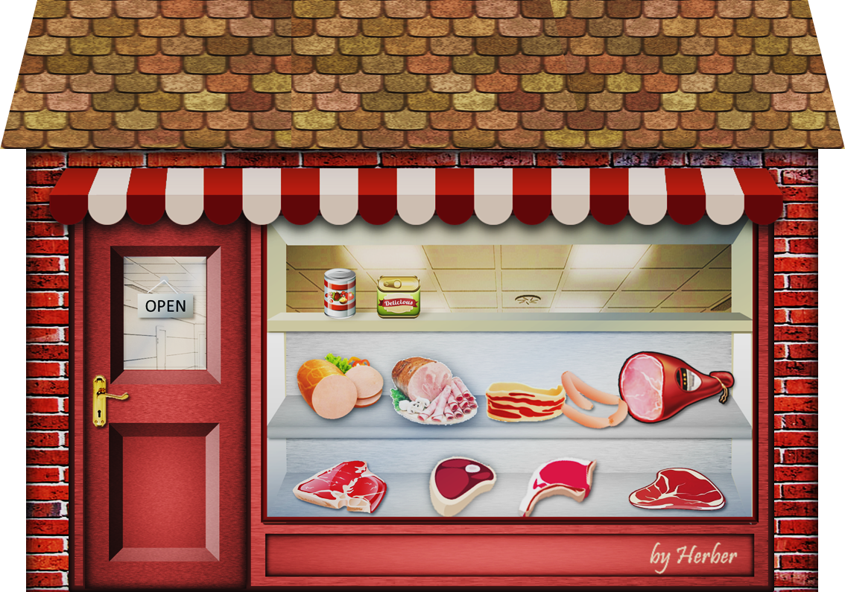
I’m going to steal some beef and sausages.
Where is he?

Slide 5
He is in the BUTCHER’S

Slide 6

I’m going to steal some plaster and medicines.
Where is he?

Slide 7
He is in the CHEMIST’S

Slide 8

I’m going to steal some coffee and drinks.
Where is he?

Slide 9
He is in the COFFEE SHOP

Slide 10

I’m going to steal some newspapers and sweets.
Where is he?

Slide 11

He is in the NEWSAGENT’S

Slide 12

I’m going to steal some sculptures and paintings.
Where is he?

Slide 13


He is in the MUSEUM

Slide 14
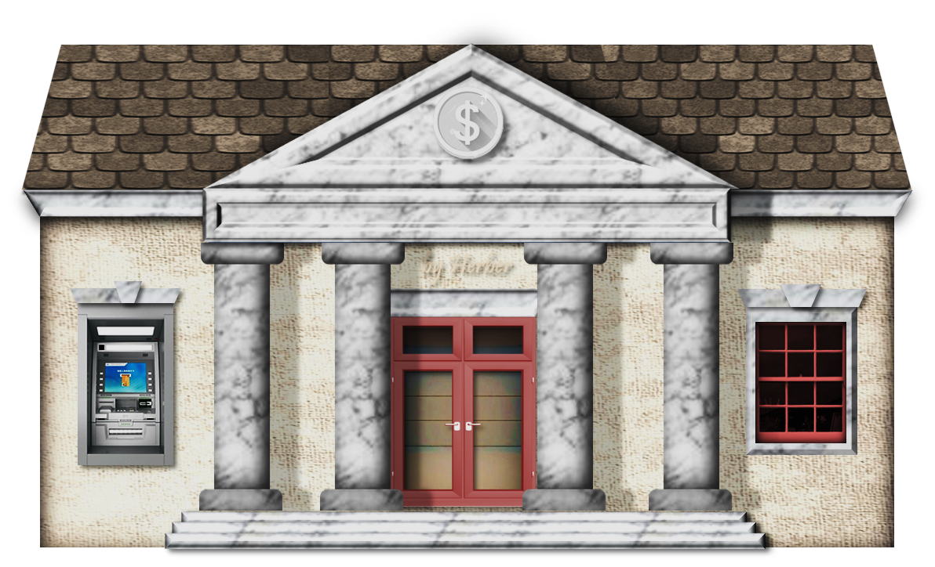
I’m going to steal some money.
Where is he?

Slide 15

He is in the BANK

Slide 16
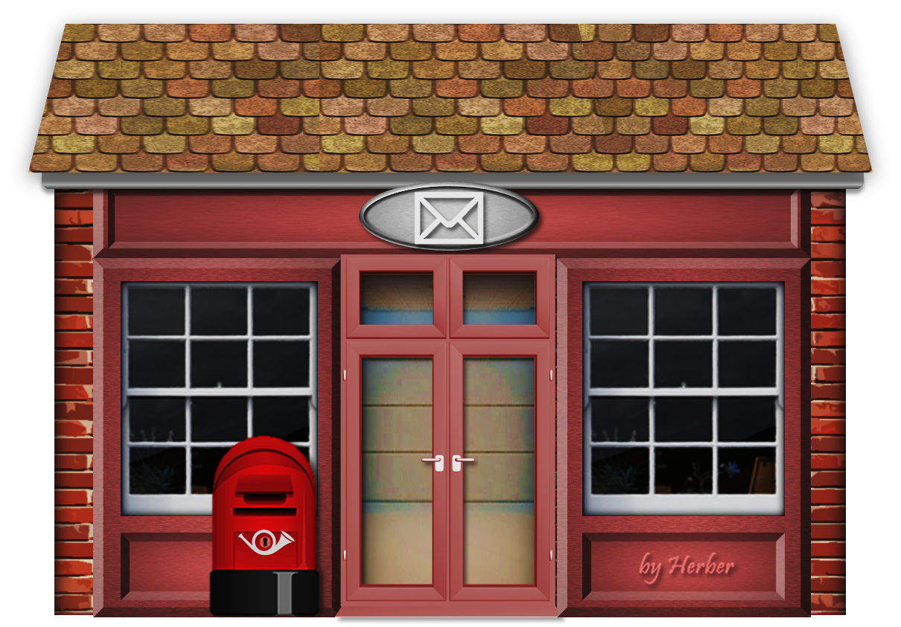
I’m going to steal some letters and parcels.
Where is he?

Slide 17

He is in the POST OFFICE

Slide 18
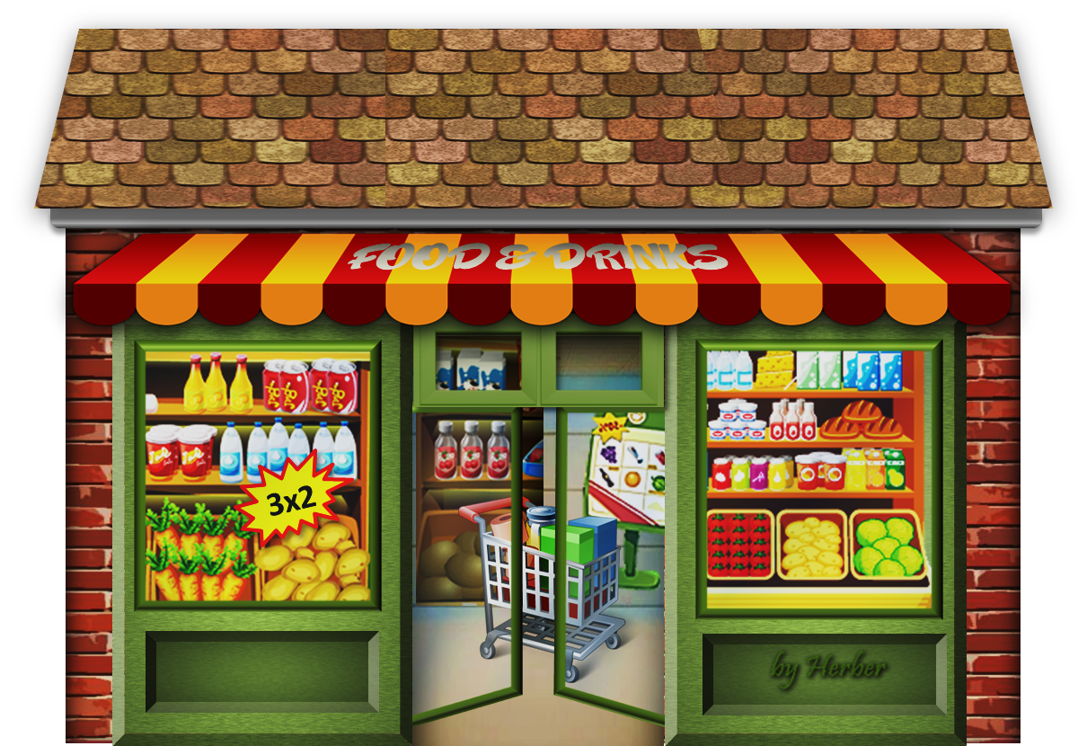
I’m going to steal some food and drinks.
Where is he?

Slide 19
He is in the SUPERMARKET

Slide 20
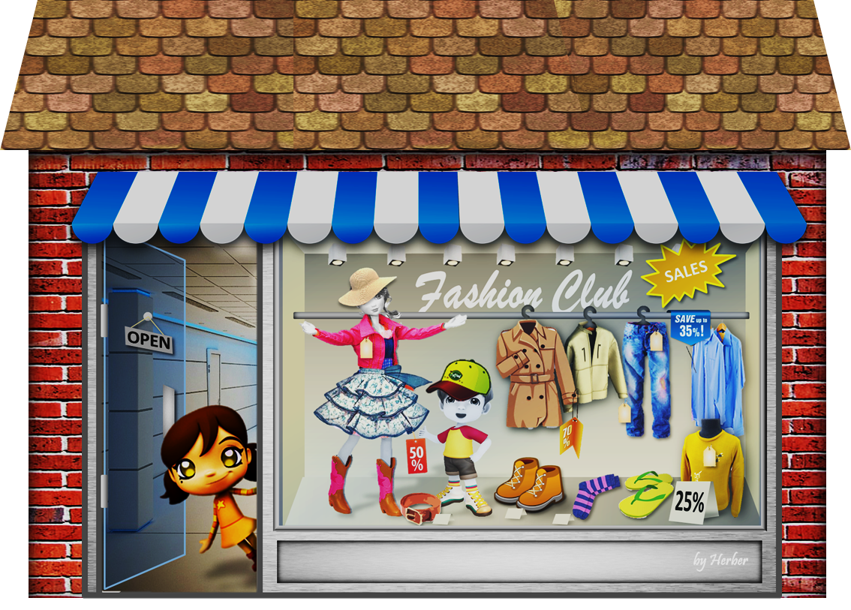
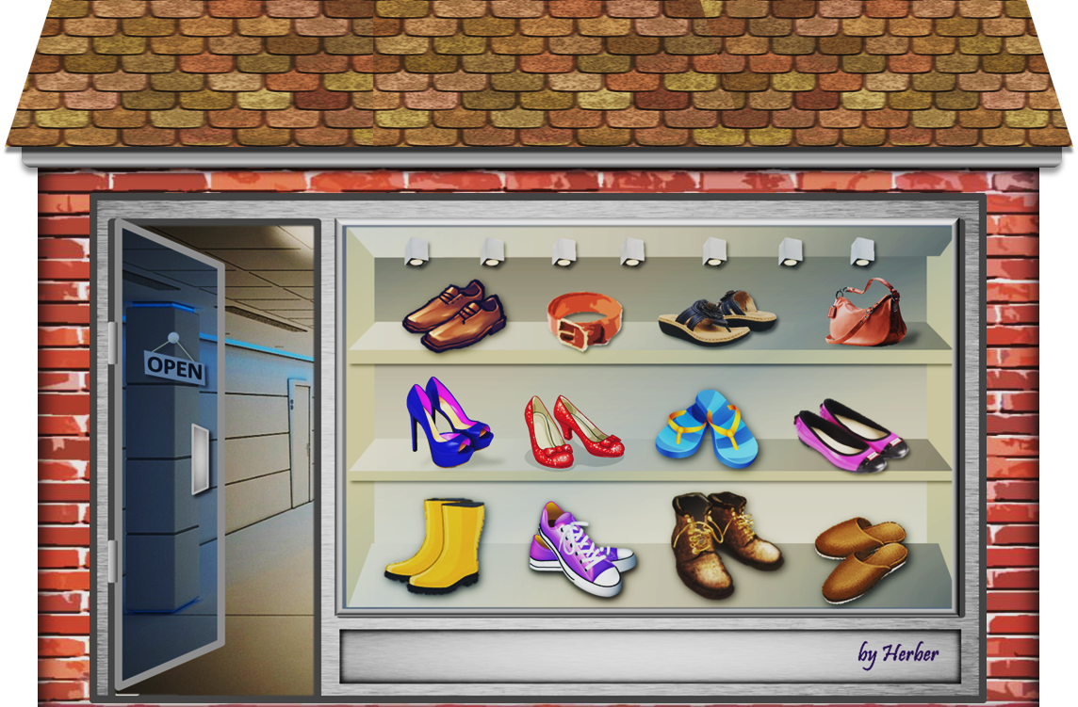
I’m going to steal some shirts and jackets.
Where is he?

Slide 21

He is in the CLOTHES SHOP

Slide 22

GOODBYE!

