Slide 1
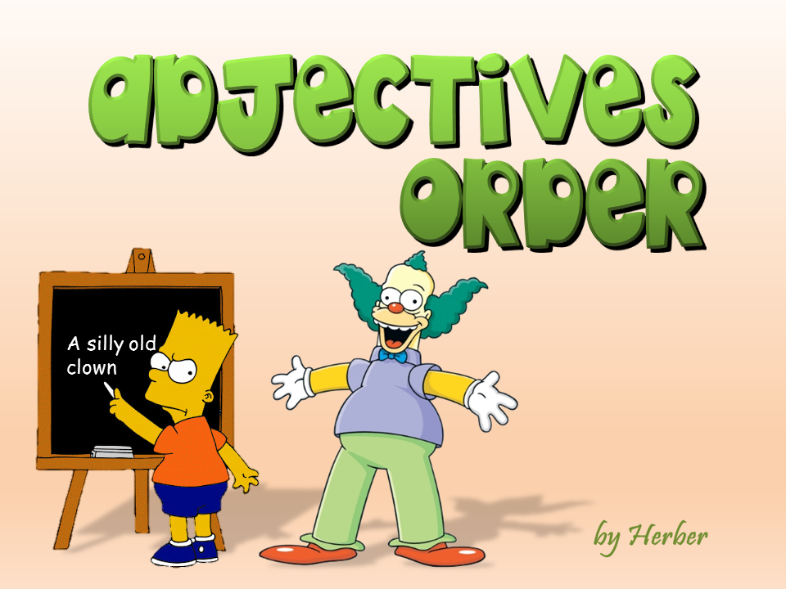


Slide 2
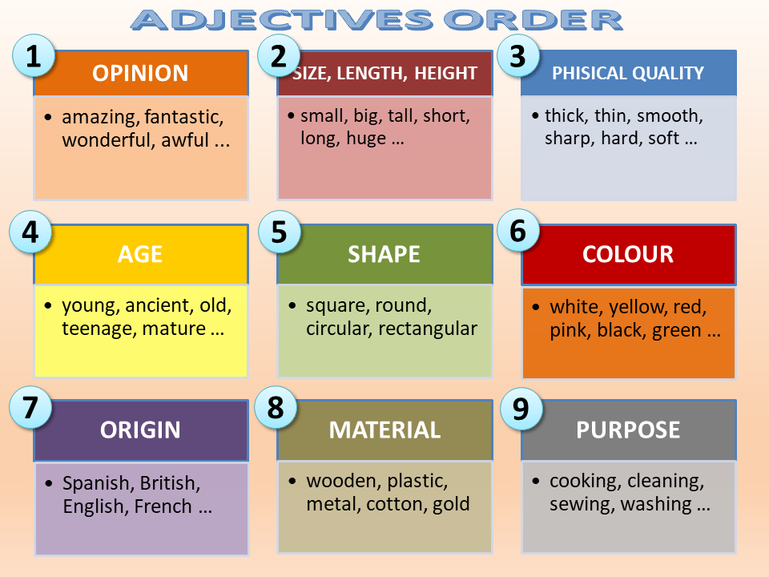

Slide 3
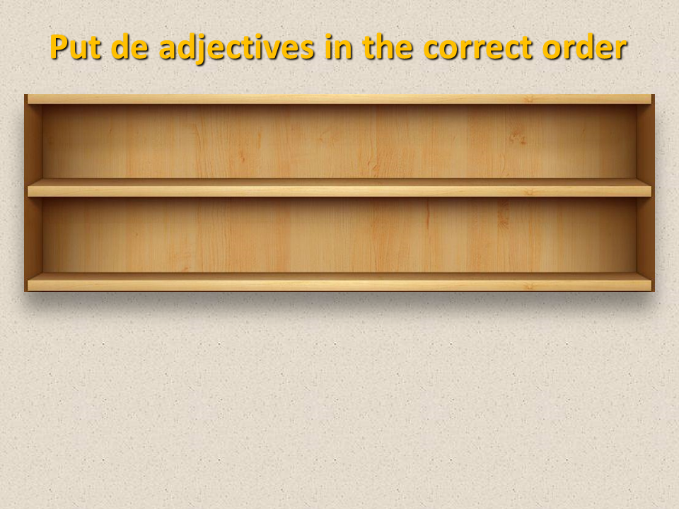
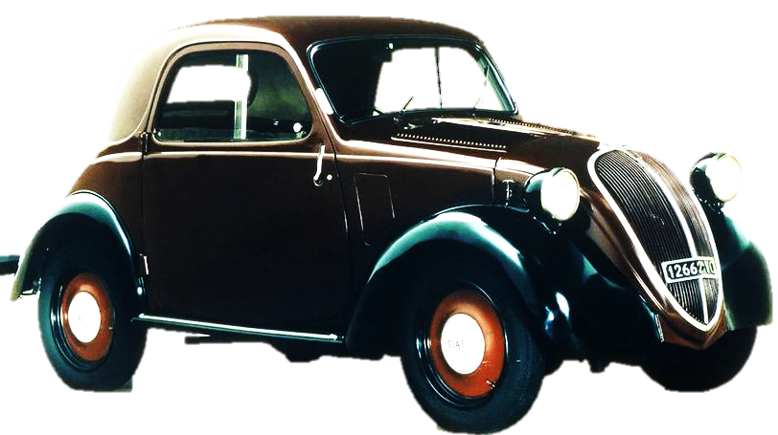
Put the adjectives in the correct order
Italian
beautiful
old
tiny
A
car

Slide 4
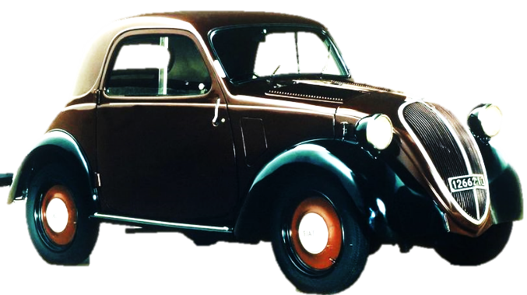

Put the adjectives in the correct order
Italian
old
tiny
A
beautiful
car

Slide 5
Put the adjectives in the correct order
Italian
old
A
beautiful
tiny
car

Slide 6
Put the adjectives in the correct order
Italian
A
beautiful
tiny
old
car

Slide 7
Put the adjectives in the correct order
A
beautiful
tiny
old
Italian
car

Slide 8
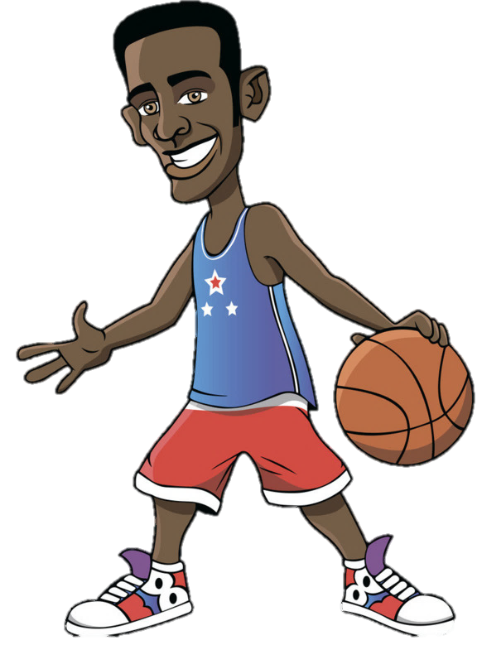
Put the adjectives in the correct order
tall
black
American
young
A
player

Slide 9

black
American
young
A
tall
player

Slide 10
Put the adjectives in the correct order
black
American
A
tall
young
player

Slide 11
Put the adjectives in the correct order
American
A
tall
young
black
player

Slide 12
Put the adjectives in the correct order
A
tall
young
black
American
player

Slide 13

Put the adjectives in the correct order
square
expensive
silver
antique
An
mirror

Slide 14
Put the adjectives in the correct order
square
silver
antique
An
expensive
mirror

Slide 15
Put the adjectives in the correct order
square
silver
An
expensive
antique
mirror

Slide 16
Put the adjectives in the correct order
silver
An
expensive
antique
square
mirror

Slide 17
Put the adjectives in the correct order
An
expensive
antique
square
silver
mirror

Slide 18
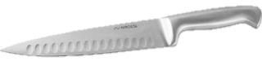
Put the adjectives in the correct order
metal
sharp
cooking
big
A
knife

Slide 19
Put the adjectives in the correct order
metal
sharp
cooking
A
big
knife

Slide 20
Put the adjectives in the correct order
metal
cooking
A
big
sharp
knife

Slide 21
Put the adjectives in the correct order
cooking
A
big
sharp
metal
knife

Slide 22
Put the adjectives in the correct order
A
big
sharp
metal
cooking
knife

Slide 23
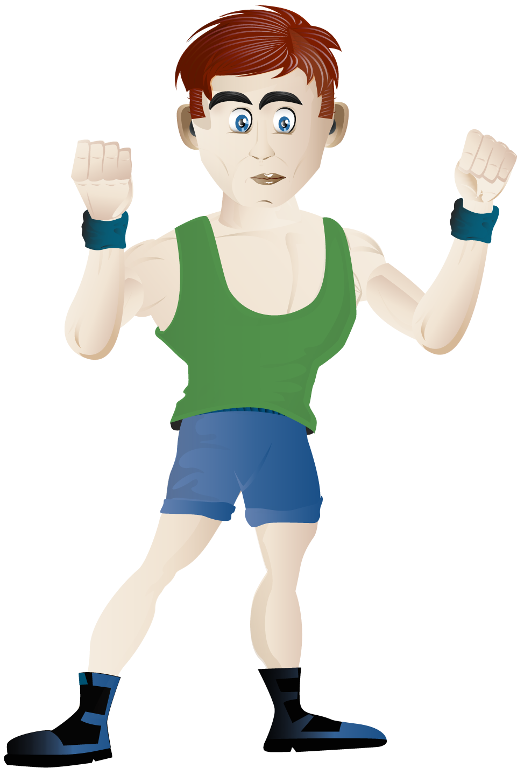
Put the adjectives in the correct order
British
smart
strong
A
teenager

Slide 24
Put the adjectives in the correct order
British
strong
A
smart
teenager

Slide 25
Put the adjectives in the correct order
British
A
smart
strong
teenager

Slide 26
Put the adjectives in the correct order
A
smart
strong
British
teenager

Slide 27
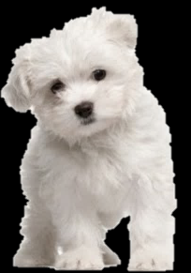
Put the adjectives in the correct order
smooth
cute
white
little
A
dog

Slide 28

Put the adjectives in the correct order
smooth
white
little
A
cute
dog

Slide 29
Put the adjectives in the correct order
smooth
white
A
cute
little
dog

Slide 30
Put the adjectives in the correct order
white
A
cute
little
smooth
dog

Slide 31
Put the adjectives in the correct order
EXIT
A
cute
little
smooth
white
dog

