Slide 1


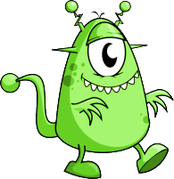
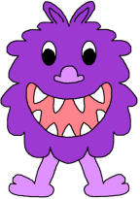
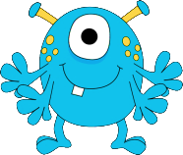
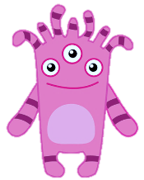
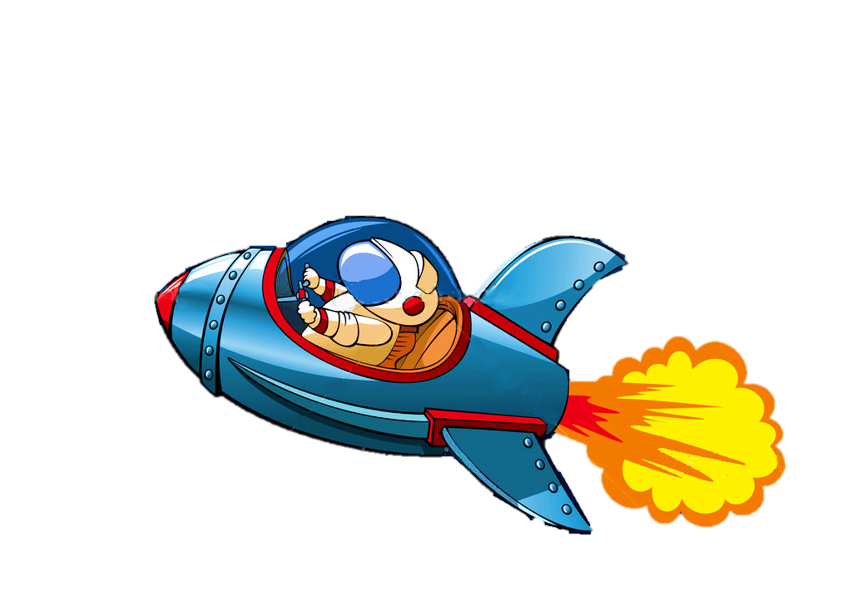

PARTS OF THE BODY

Slide 2


I’m travelling to the PINK PLANET

Slide 3
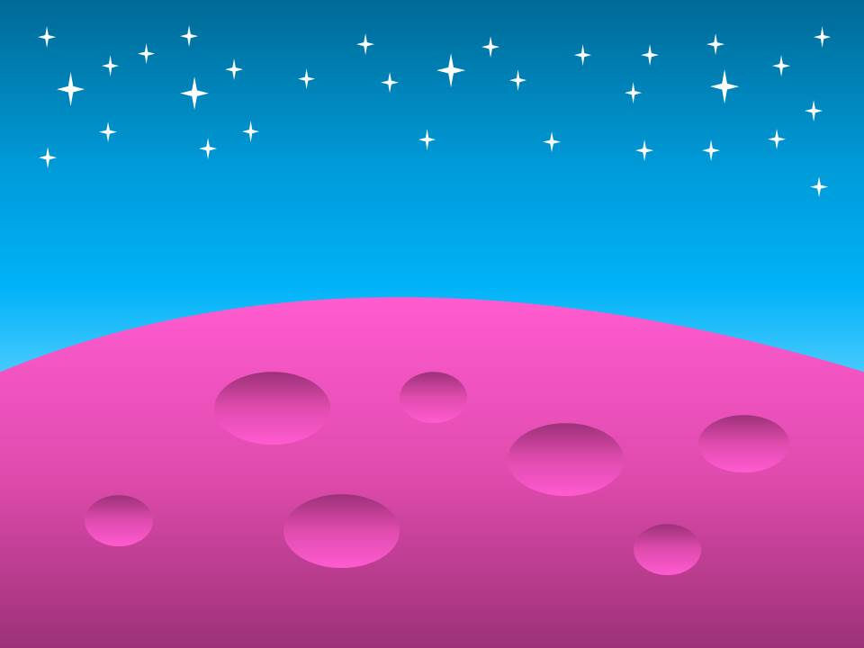

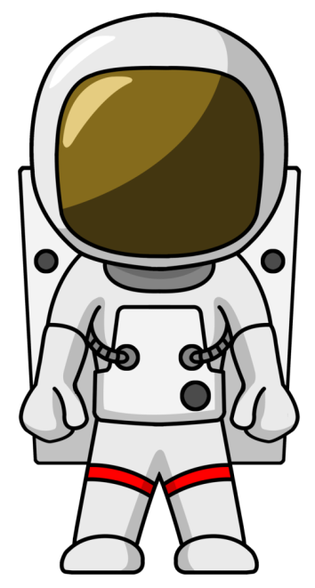
Let’s see how its inhabitants look like.

Slide 4

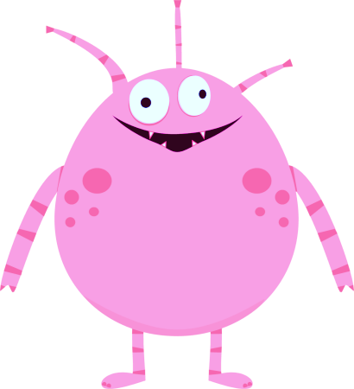



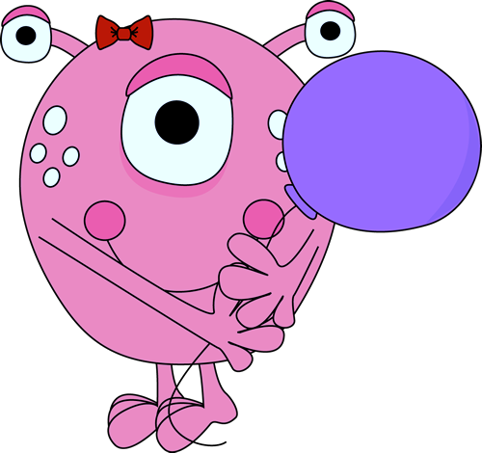
It has got three eyes, two hands
with four fingers, and two feet.
It has also got some white spots on its face.
Yes, it’s me.
NEXT
Click on the right monster

Slide 5

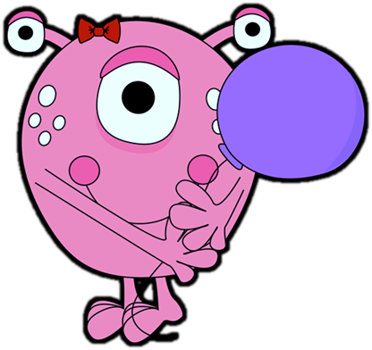
It has got two eyes, two hands
with three fingers, and two horns.
It has also got two big feet and a hairy body.
Yes, it’s me.
NEXT

Slide 6

It has got three eyes, two arms,
two feet, some hair, and a light tummy.
Yes, it’s me.
NEXT

Slide 7

It has got two eyes, two horns, and a big mouth with three teeth. It has also got a tail
and two feet with three toes.
Yes, it’s me.
NEXT

Slide 8
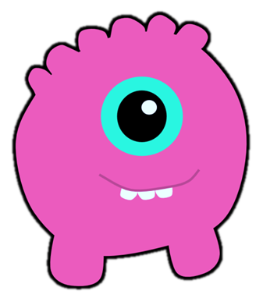
It has got one big eye, a mouth with three teeth, and two short legs.
Yes, it’s me.
NEXT

Slide 9
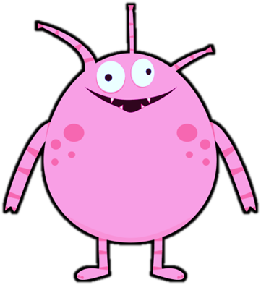
It has got two eyes, a mouth with small teeth, and three antennas. It has also got two long arms and two short legs with small feet.
Yes, it’s me.
NEXT

Slide 10

I’m travelling to the GREEN PLANET

Slide 11

Let’s see how its inhabitants look like.

Slide 12

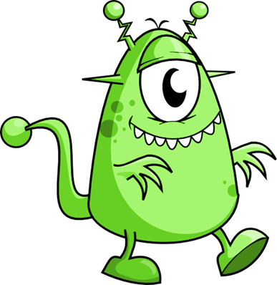
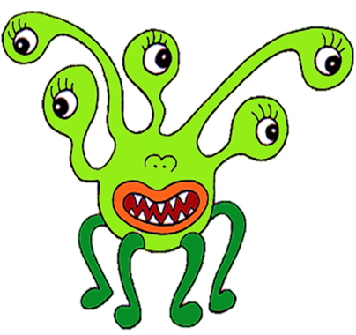

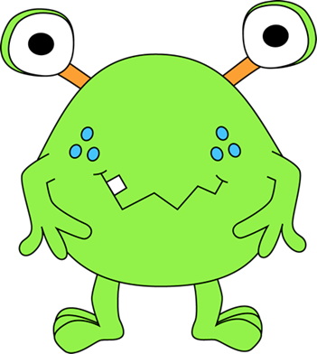
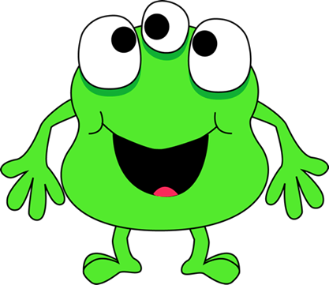
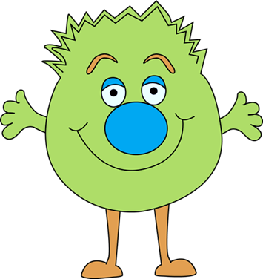
It has got a big mouth, a small nose, and five eyes. It has also got four legs with small feet.
Yes, it’s me.
NEXT

Slide 13
It has got three eyes and a big mouth.
It has also got two hands with four fingers and two small feet with two toes.
Yes, it’s me.
NEXT

Slide 14
It has got two eyes and a mouth with one tooth. It has also got two hands with three fingers and two feet with three toes.
Yes, it’s me.
NEXT

Slide 15
It has got two antennas, a mouth with many teeth, a long tail, and four feet.
Yes, it’s me.
NEXT

Slide 16
It has got two antennas, a mouth with many teeth, a big eye, and two pointed ears. It has also got two hands with three fingers, a long tail, and two feet.
Yes, it’s me.
NEXT

Slide 17
It has got two eyes, a big nose, and a big mouth.
It has also got two hands with four fingers, two long legs, and two small feet.
Yes, it’s me.
NEXT

Slide 18
I’m travelling to the PURPLE PLANET

Slide 19

Let’s see how its inhabitants look like.

Slide 20
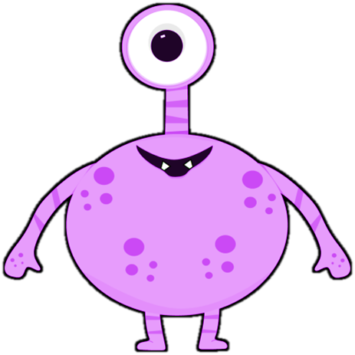
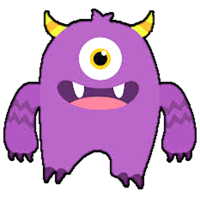
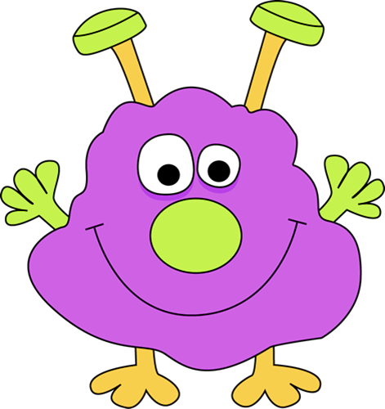
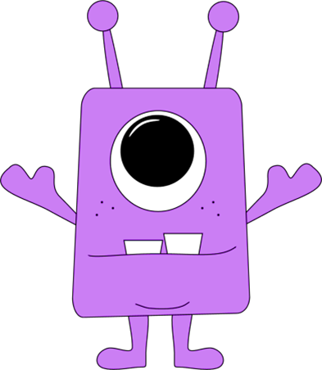
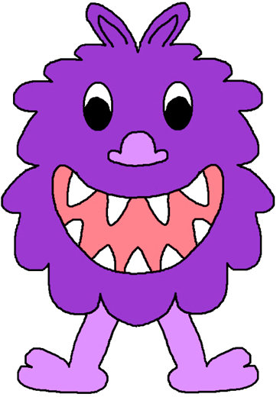
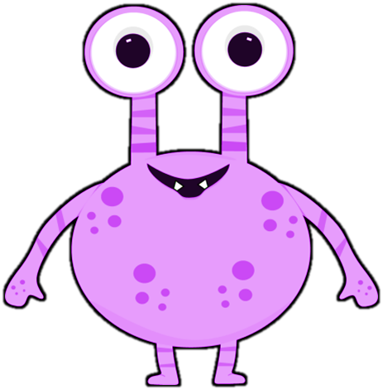
It has got two eyes, a small mouth with two small teeth, two arms, and two short legs with small feet.
It has also got some spots on its body.
Yes, it’s me.
NEXT

Slide 21
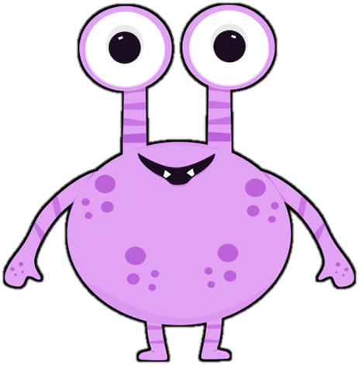
It has got one big eye, a mouth with two teeth, two antennas, two arms, two short legs, and two small feet.
Yes, it’s me.
NEXT

Slide 22
It has got one big eye, a mouth with two small teeth,
two arms, two short legs, and two small feet.
Yes, it’s me.
NEXT

Slide 23
It has got two eyes, two ears, a nose, and a big mouth with nine teeth. It has also got two legs, two feet with two toes, and a hairy body.
Yes, it’s me.
NEXT

Slide 24
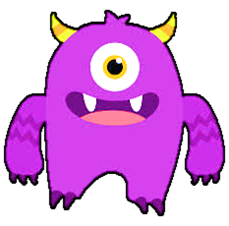
It has got one big eye, two horns, a big mouth with two teeth, and a tongue. It has also got two arms with three fingers and two legs with two toes.
Yes, it’s me.
NEXT

Slide 25
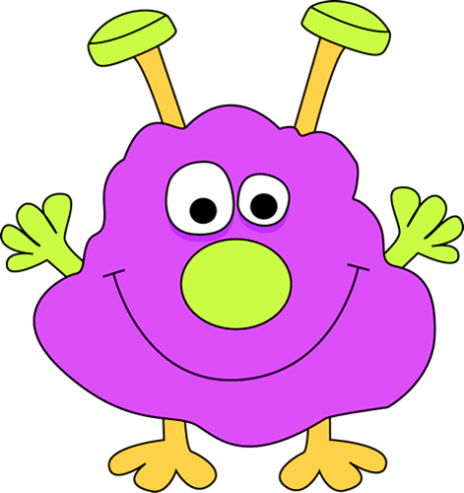
It has got two eyes, two antennas, a big green nose, and two green hands with four fingers.It has also got two orange feet with three toes.
Yes, it’s me.
NEXT

Slide 26
I’m travelling to the BLUE PLANET

Slide 27

Let’s see how its inhabitants look like.

Slide 28
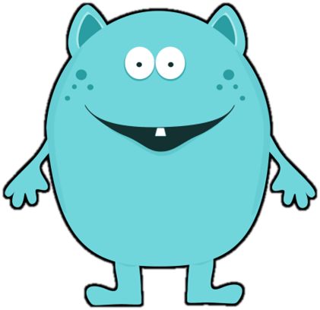
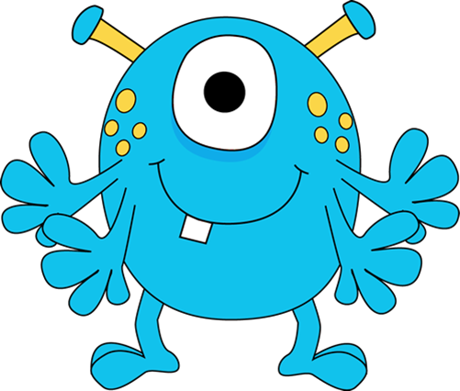
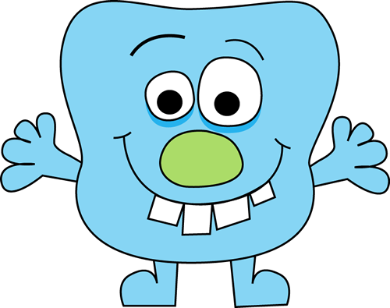
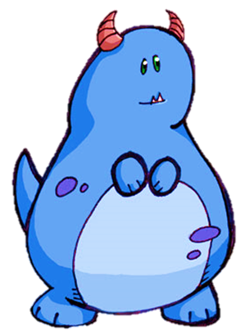

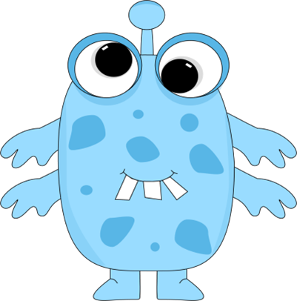
It has got two eyes, a small mouth with two teeth, an antenna, and some spots on his body. It has also got four hands with three fingers and two small feet.
Yes, it’s me.
NEXT

Slide 29
It has got one big eye, two antennas, a mouth with one tooth, and some yellow spots. It has also got four hands with four fingers and two feet with two toes.
Yes, it’s me.
NEXT

Slide 30
It has got one big eye, two small eyes, and some spots. It has also got two legs and two black feet.
It hasn’t got any mouth.
Yes, it’s me.
NEXT

Slide 31
It has got two eyes, one big green nose, and a big mouth with four teeth. It has also got two hands with four fingers and two feet.
Yes, it’s me.
NEXT

Slide 32
It has got two eyes, two ears, and a mouth with one small tooth. It has also got two hands with four fingers and two feet.
Yes, it’s me.
NEXT

Slide 33
It has got two small eyes, two horns, and a small mouth with two small tooth. It has also got two hands and two feet.
Yes, it’s me.
NEXT

Slide 34
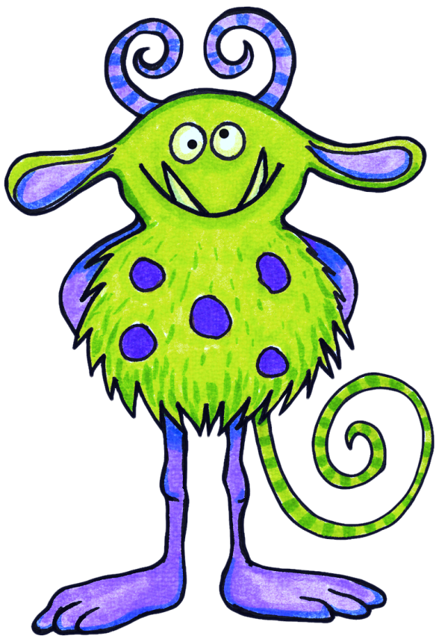
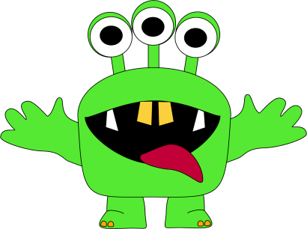
Can you describe these monsters?
NEXT

Slide 35
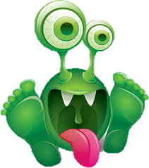
SEE YA!
EXIT

